Slide 1
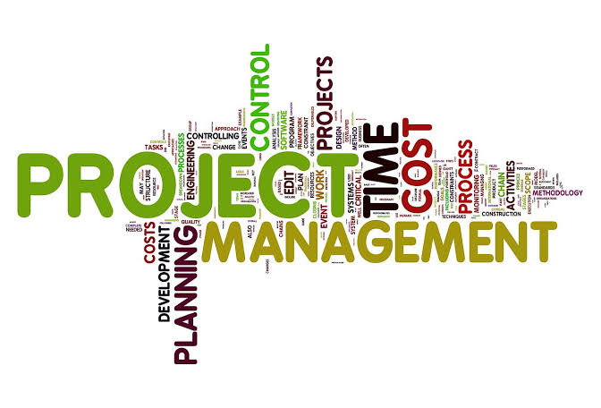
Dr. Farrukh Zeshan

Slide 2
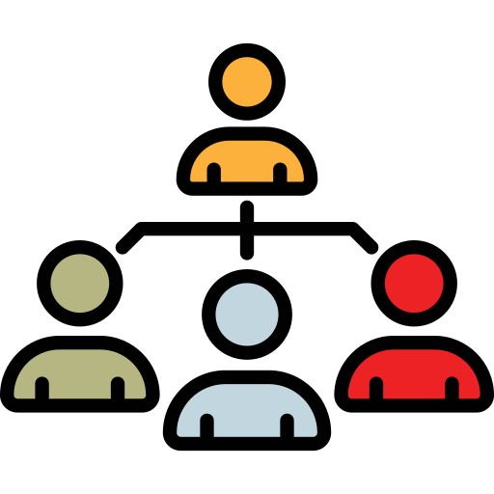
Organizational Structures
Functional
Weak Matrix
Balanced Matrix
Strong Matrix
Projectized

Slide 3
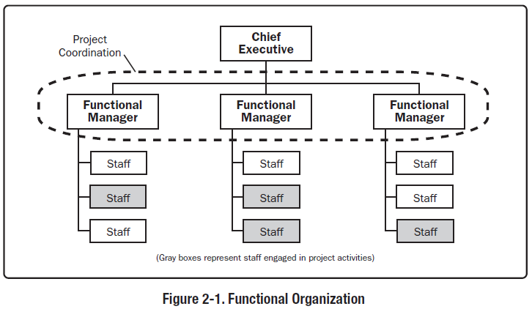
Functional Organization
.

Slide 4
Functional Organization
Grouped by areas of specialization/ functions. Power is with the functional leader.
Advantages: Access to specialists; members reporting to only one supervisor, clearly defined career paths
Disadvantages: less focus on project deliverables, no career path on Project Management, PM has no authority.

Slide 5
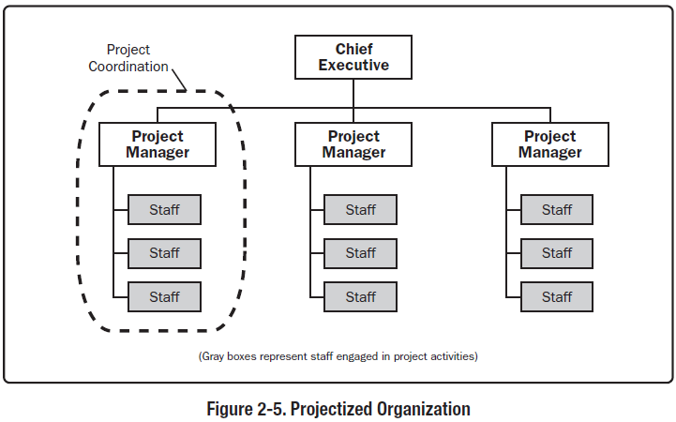
Projectized Organization

Slide 6
Projectized Organization
Organization is by projects. Personnel report to PM/has total power.
Advantages: Efficient project organization - Loyalty to the project - effective communications.
Disadvantages: Duplication of facilities.
No career path

Slide 7
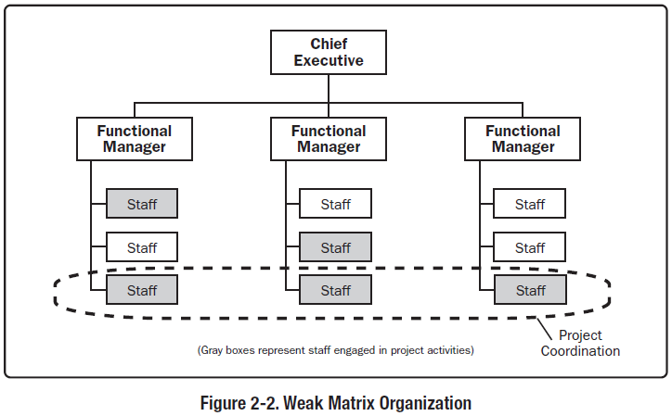
Weak Matrix Organization
.

Slide 8
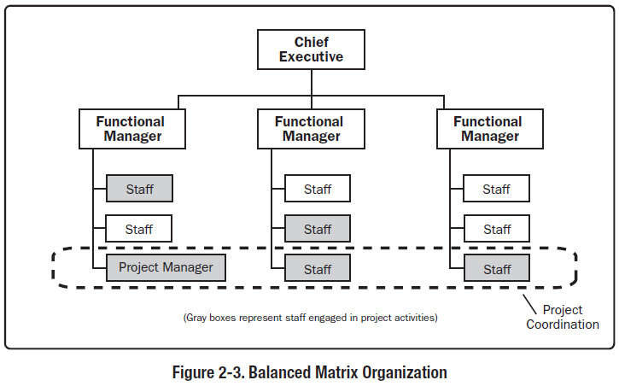
Balanced Matrix
Organization

Slide 9
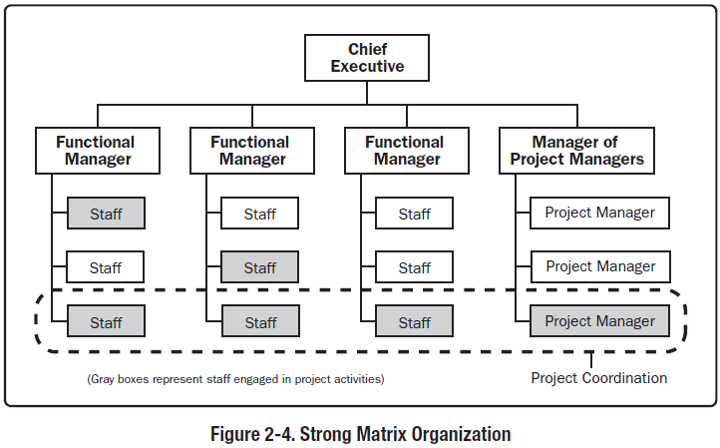
Strong Matrix Organization

Slide 10
Matrix Organization
Power varies between Project & Functional managers according to its type (strong, balanced or weak)
Advantages:
Maximum utilization of occasional resources
Efficient horizontal & vertical distribution of information
Retention of home after project closure.

Slide 11
Matrix Organization
Disadvantages:
Different priorities between PM & FM (Conflicts)
Dual reporting
Complex to monitor and control

Slide 12
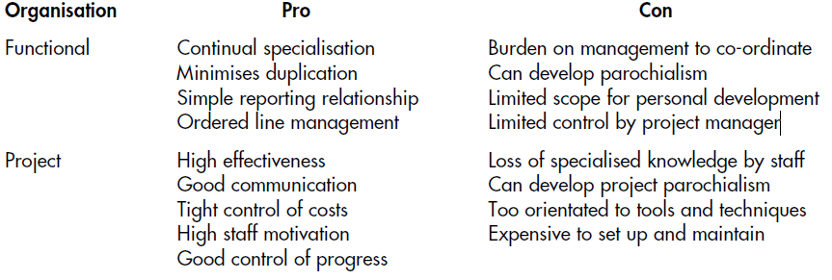
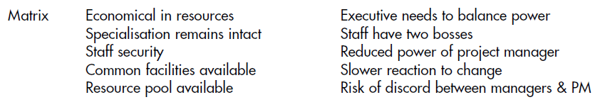

Slide 13
PMO
A management structure that standardizes the project-related governance processes and facilitates the sharing of resources, methodologies, tools and techniques.
Provides dedicated training, enterprise-wide project management software, Coordinates overall project quality standards.
PMO may have the authority to act as an integral stakeholder and a key decision maker through the life of the project .

Slide 14
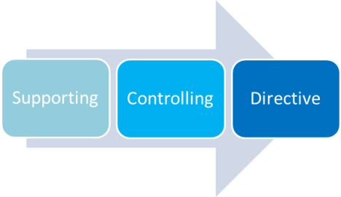
PMO

Slide 15
Aslam is a project manager in a company that regularly builds teams to create products for clients. When the product is delivered, the team is dissolved & assigned to other projects. What kind of organization is that?
A. Projectized
B.Weak matrix
C.Functional
D.Strong matrix

Slide 16
A manager that manages a group of related projects is called a:
1. Project manager.
2. Project expediter.
3. Program coordinator.
4. Program manager

Slide 17
You are a project manager leading a cross-functional project. None of your project team members report to you functionally and you do not have the ability to directly reward their performance. The project is difficult, involving tight date constraints and challenging quality standards. Which of the following type of organization would you be in this circumstance?
1. Projectized
2. Functional
3. Strong Matrix
4. Operations

Slide 18
A project manager works in a company favoring the weakest authority for the project manager. The type of organization that holds the project manager to be the weakest is:
1. Projectized organization.
2. Strong matrix organization.
3. Weak matrix organization.
4. Balanced matrix.

Slide 19
Any company or governmental rules or regulations on how you need to plan quality for your project are considered _________.
a) Organizational process assets
b) Requirements documentation
c) Enterprise environmental factors
d) Project Management plan

Slide 20
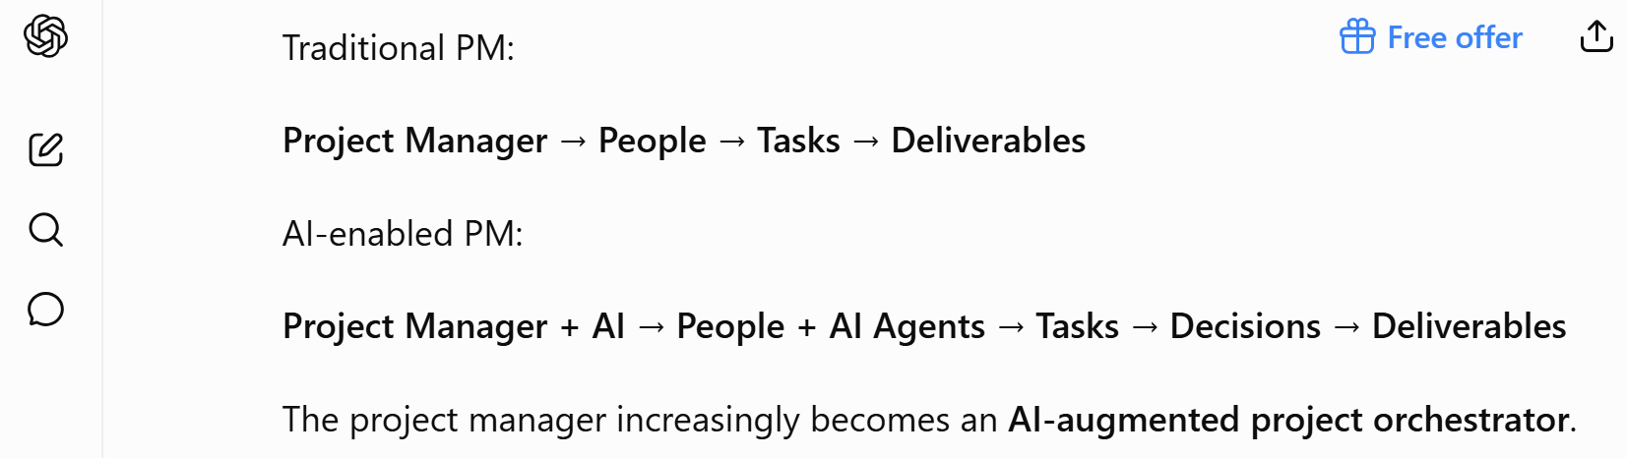
Project Management in AI era

Slide 21
Software Development Lifecycle
The software development lifecycle (SDLC) is the cost-effective and time-efficient process that development teams use to design and build high-quality software.
The goal of SDLC is to minimize project risks through forward planning so that software meets customer expectations during production and beyond.
This methodology outlines a series of steps that divide the software development process into tasks you can assign, complete, and measure.

Slide 22
Software Development Lifecycle
The way you organize your activities
The steps through which the product progresses
  Requirements phase
  Specification phase
  Design phase
  Implementation phase
  Integration phase
  Maintenance phase
  Retirement

Slide 23
Facts
The software industry has some 60 named methodologies and perhaps as many as 30 hybrids, such as Agile+waterfall.
New software development methodologies come out about every 7 months
No known methodology is 100% effective for all sizes, types, and classes of software.

Slide 24
Selection Criteria
Product, Service, or Result
Degree of innovation
Requirements certainty
Scope stability Delivery options
Risk Tolerance The organization
Skills of the employees
The nature of the product
Project Size and Complexity
Customer Involvement and Feedback
Project Constraints (Time and Budget)

Slide 25
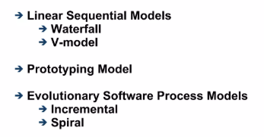
Model Categories

Slide 26
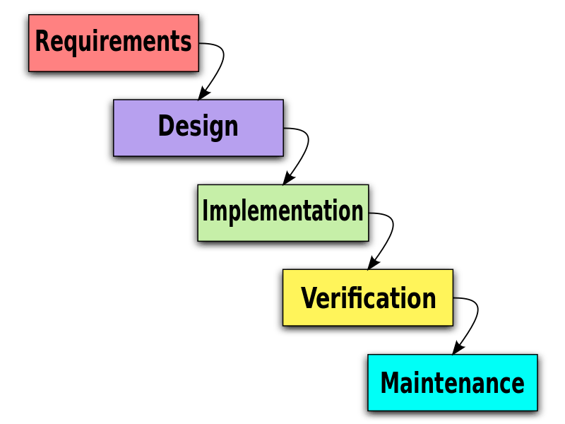
Waterfall Model
Characterized by
  Feedback loops
  Documentation-driven
Advantages
  Documentation
  Maintenance easier

Slide 27
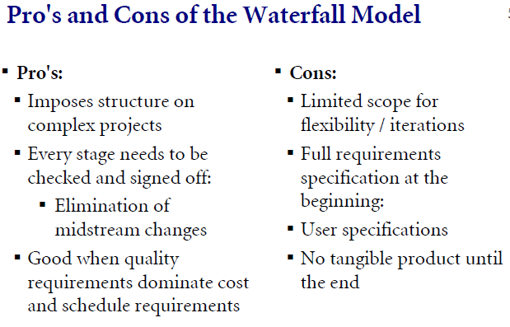

Slide 28
Waterfall Model
Idealized, doesn’t match reality well.
Unrealistic to expect accurate requirements so early in project.
Software is delivered late in project, delays discovery of serious errors.
Difficult to integrate risk management.
Difficult and expensive to make changes to documents, ”swimming upstream”.

Slide 29
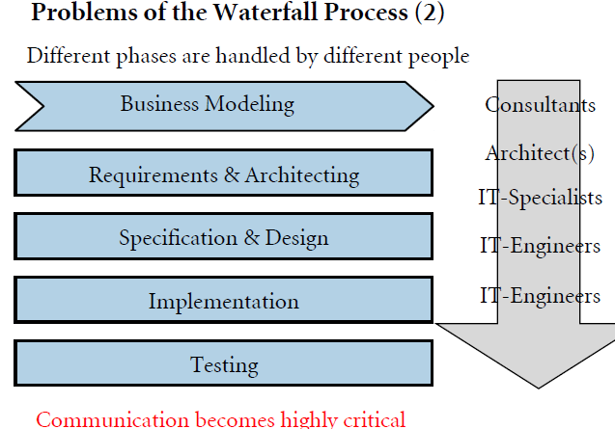

Slide 30
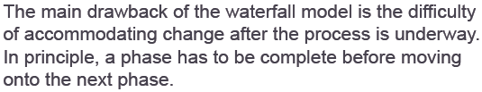
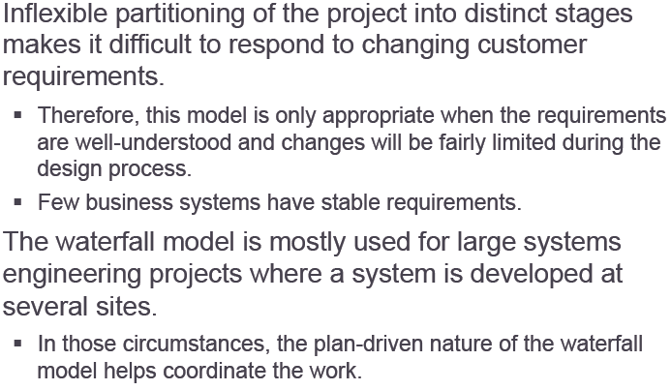
Waterfall Model

Slide 31
Use Waterfall Model When
Requirements are very well known
Product definition is stable
Technology is understood
New version of an existing product
Porting an existing product to a new platform.

Slide 32
Key Points
Pure Waterfall Approx. 10%
Hybrid Approx. 50-60%

Slide 33
V Model
The V model is a variant of the waterfall model.
V-Model is for industries where failure is not an option.
It represents a tacit recognition that there are testing activities occuring throughout the waterfall software life cycle model and not just during the software testing period.

Slide 34
V Model
The "V" shape visually represents the relationship between each development phase on the left side of the V and its corresponding testing phase on the right side

Slide 35
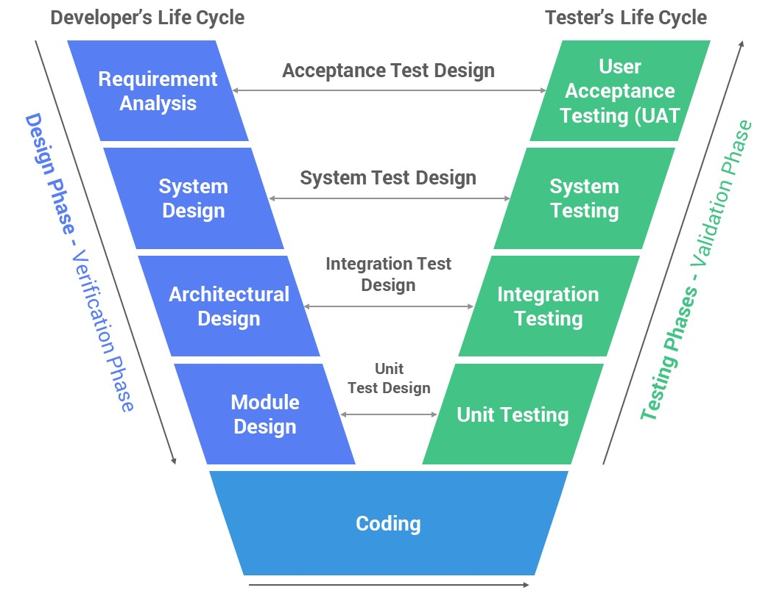
V Model

Slide 36
V Model
V model is Verification and Validation model
Is a sequential path of exe of processes
Each phase must be completed before next
Testing is parallel with corresponding development phase
Good for small to medium
Requirements must be clear
Technical resource must be available

Slide 37
Advantages
High Quality Software : testing at every level
Time and Cost: Finding a flaw in requirements early phase is cheaper
Clarity: Everyone knows what is expected at each stage.
Avoid defects to flow
It enables project management to track progress accurately.
Documentation make easier to trace and manage changes to the software.

Slide 38
Disadvantages
Inflexible and Rigid: very difficult to change requirements once moved down
Client does not see product until end
The V-Model can be time-consuming, requires a lot of documentation and testing.
It is not good for complex
The V-Model places a strong emphasis on documentation, which can lead to an overreliance on documentation at the expense of actual development work.

Slide 39
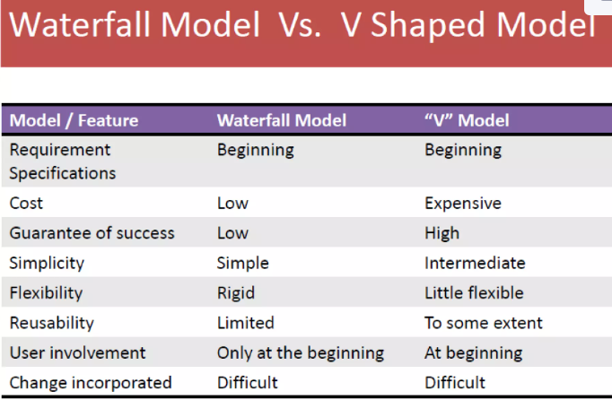

Slide 40
When to Use
Use for small projects where requirements are clear.
Need high degree of success
Technical resources are available
No prototype; customer must agree

Slide 41
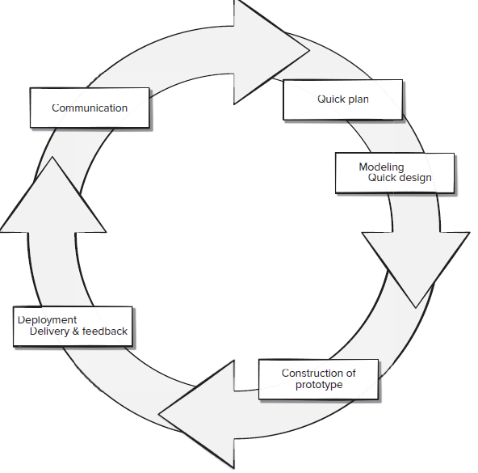
Rapid Prototyping Model
Customers are non-technical and usually don’t know what they want/can have.

Slide 42
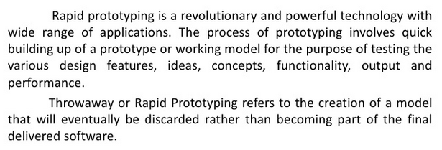
Rapid Prototyping Model

Slide 43
Rapid Prototyping Model
Developers build a prototype during the requirements phase
Prototype is evaluated by end users
Users give corrective feedback
Developers further refine the prototype
When the user is satisfied, the prototype code is brought up to the standards needed for a final product.

Slide 44
Rapid Prototyping Model
A preliminary project plan is developed
An partial high-level paper model is created
The model is source for a partial requirements specification
A prototype is built with basic and critical attributes
The designer builds
  the database
  user interface
  algorithmic functions
The designer demonstrates the prototype, the user evaluates for problems and suggests improvements.
This loop continues until the user is satisfied

Slide 45
Strengths
Customers can “see” the system requirements as they are being gathered
A more accurate end product
Unexpected requirements accommodated
Allows for flexible design and development
Steady, visible signs of progress produced
Interaction with the prototype stimulates awareness of additional needed functionality

Slide 46
Weaknesses
Bad reputation for “quick-and-dirty” methods
Overall maintainability may be overlooked
The customer may want the prototype delivered.
Process may continue forever (scope creep)

Slide 47
Weaknesses
An unstable/badly implemented prototype often becomes the final product.
Requires extensive customer collaboration
  Costs customers money
  Needs committed customers
  Difficult to finish if customer withdraws
  May be too customer specific, no broad market
  Difficult to know how long project will last
4. Easy to fall back into code-and-fix without proper requirements analysis, design, customer evaluation and feedback.

Slide 48
Use Rapid Prototyping Model When
Requirements are unstable or have to be clarified
As the requirements clarification stage of a waterfall model
Develop user interfaces
Short-lived demonstrations
New, original development

Slide 49
Key Points
Rapid prototyping may replace specification phase—never the design phase
  Waterfall model + Rapid prototyping

Slide 50
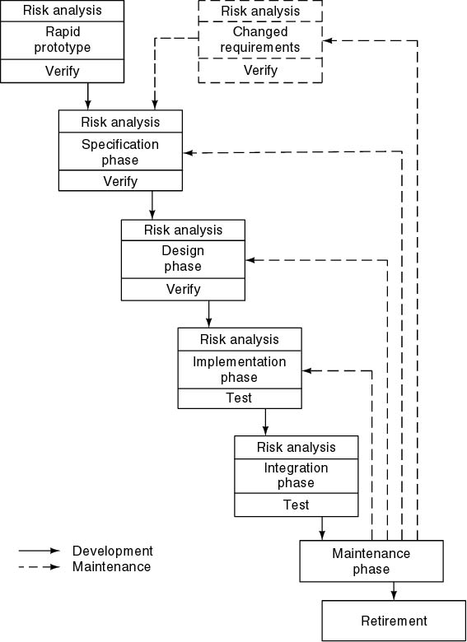
Evolutionary Process Model
Spiral Model
Simplified form
  Waterfall model plus risk analysis
Precede each phase by
  Alternatives (build, reuse, buy, sub-contract)
  Risk analysis (lack of experience, new technology, tight schedules)
Follow each phase by
  Evaluation
  Planning of next phase

Slide 51
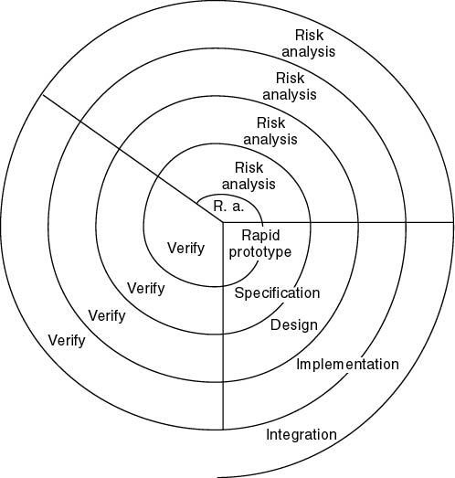
Simplified Spiral Model
If risks cannot be resolved, project is immediately terminated

Slide 52
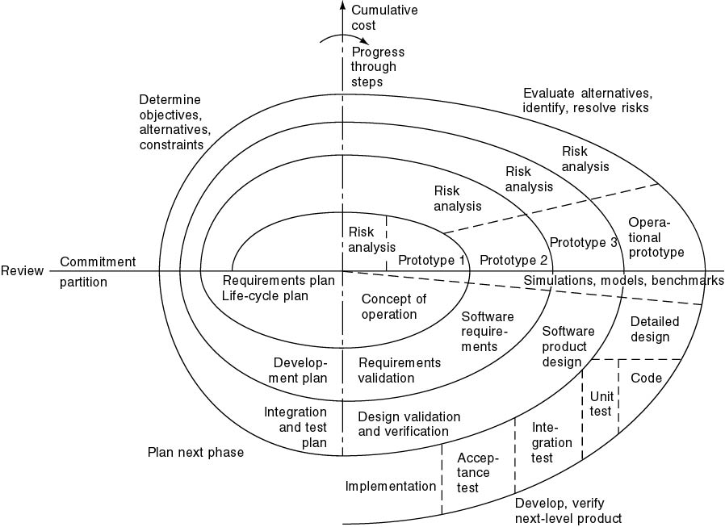
Full Spiral Model
Typical activates:
  Create a design
  Review design
  Develop code
  Inspect code
  Test product

Slide 53
Spiral Model Strengths
Users see the system early because of rapid prototyping tools
Critical high-risk functions are developed first
The design does not have to be perfect
Users can be closely tied to all lifecycle steps
Early and frequent feedback from users
Cumulative costs assessed frequently

Slide 54
Spiral Model Weaknesses
Time spent for evaluating risks too large for small or low-risk projects
Time spent planning, resetting objectives, doing risk analysis and prototyping may be excessive
The model is complex
Risk assessment expertise is required
Spiral may continue indefinitely
Developers must be reassigned during non-development phase activities

Slide 55
Spiral Model Weaknesses
  For large-scale software only
  For internal (in-house) software only

Slide 56
Use Spiral Model When
When costs and risk evaluation is important
For medium to high-risk projects
Users are unsure of their needs
Requirements are complex
New product line
Significant changes are expected (research and exploration)

Slide 57
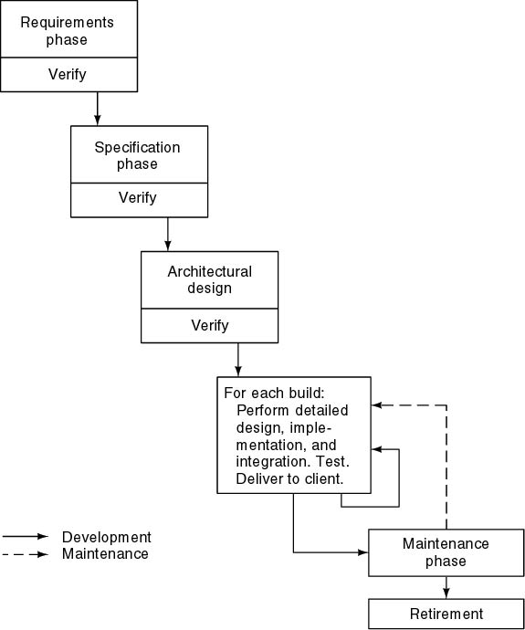
Incremental Model
Divide project into builds
Construct a partial implementation of a total system
Then slowly add increased functionality
The incremental model prioritizes requirements of the system and then implements them in groups.
Each subsequent release of the system adds function to the previous release, until all designed functionality has been implemented.

Slide 58
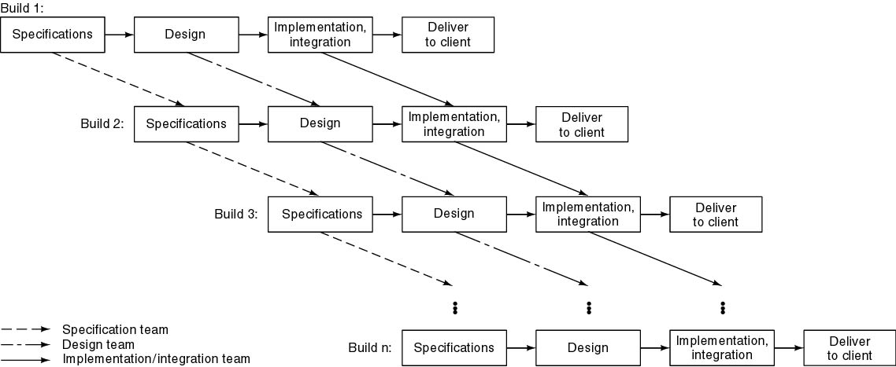
Incremental Model

Slide 59
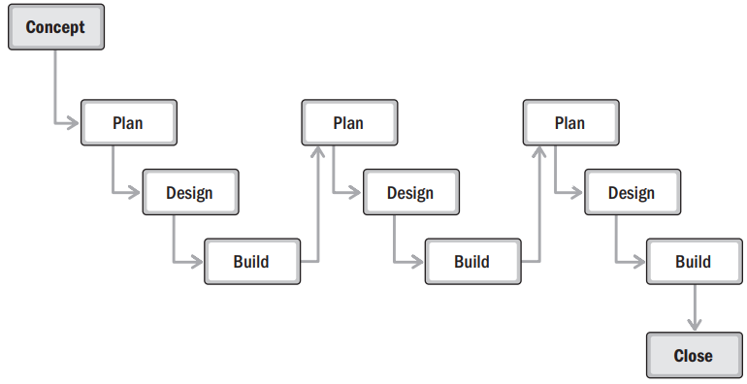

Slide 60
Incremental Model
Waterfall, rapid prototyping models
  Operational quality complete product at end
Incremental model
  Operational quality portion of product within weeks
Smaller capital outlay, rapid return on investment

Slide 61
Incremental Model Strengths
Develop major functions first
Each release delivers an operational product
Customer can respond to each build
Uses “divide and conquer” breakdown of tasks
Lowers initial delivery cost
Initial product delivery is faster
Customers get important functionality early
Risk of changing requirements is reduced

Slide 62
Incremental Model Weaknesses
Requires good planning and design
Requires early definition of a complete and fully functional system to allow for the definition of increments
Well-defined module interfaces are required
Total cost of the complete system is not lower

Slide 63
Use Incremental Model When
Funding, schedule, program complexity, or need for early realization of benefits.
Most of the requirements are known up-front but are expected to evolve over time
A need to get basic functionality to the market early
On projects which have lengthy development schedules
On a project with new technology
When requirements are defined precisely and no confusion on final product functionality.
Delivers quick product with limited functionality.

Slide 64
Agile Development
The agile model arranges the SDLC phases into several development cycles.
The team iterates through the phases rapidly, delivering only small, incremental software changes in each cycle.
They continuously evaluate requirements, plans, and results so that they can respond quickly to change.
The agile model is both iterative and incremental, making it more efficient than other process models.

Slide 65
Key Attributes
Iterative and Incremental: Development happens in short cycles (sprints) where each cycle delivers a working product.
Collaboration and Communication: Agile emphasizes collaboration between dev team, stakeholders, and customers.
Adaptability and Flexibility: Agile frameworks allow for changes based on feedback and evolving requirements.
Continuous Feedback: Stakeholders provide feedback at the end of each iteration, allowing for course correction and improvement.
Customer-Centric: Agile focuses on delivering value to the customer continuously.

Slide 66
Extreme Programming
Stories (features client wants)
Estimate duration and cost of each story
Select stories for next build
Each build is divided into tasks
Test cases for task are drawn up first
Pair programming
Continuous integration of tasks

Slide 67
Extreme Programming
For small-to-medium-sized teams developing software with vague or rapidly changing requirements
Coding is the key activity throughout a software project
Communication among teammates is done with code
Life cycle and behavior of complex objects defined in test cases – again in code

Slide 68
Extreme Programming
Planning game – determine scope of the next release by combining business priorities and technical estimates
Small releases – put a simple system into production, then release new versions in very short cycle
Simple design – system is designed as simply as possible (extra complexity removed as soon as found)
Testing – programmers continuously write unit tests; customers write tests for features
Refactoring – programmers continuously restructure the system without changing its behavior to remove duplication and simplify

Slide 69
Extreme Programming
Pair-programming -- all production code is written with two programmers at one machine
Collective ownership – anyone can change any code anywhere in the system at any time.
Continuous integration – integrate and build the system many times a day – every time a task is completed.
40-hour week – work no more than 40 hours a week as a rule
On-site customer – a user is on the team and available full-time to answer questions
Coding standards – programmers write all code in accordance with rules emphasizing communication through the code

Slide 70
Extreme Programming
Review code all the time (pair programming)
Everybody will test the code
Everybody will design daily (refactoring)
Everybody will work at defining and refining the architecture
Build, integrate and test continuous

Slide 71
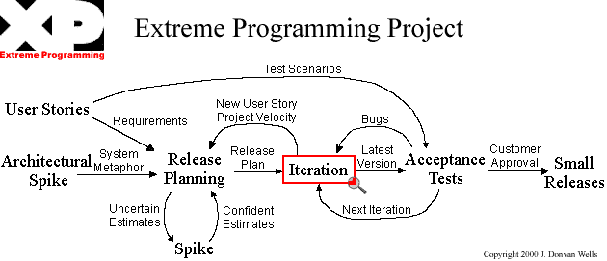
Extreme Programming

Slide 72
Unusual Features of XP
Computers are put in center of large room lined with cubicles
Client representative is always present
Cannot work overtime for 2 successive weeks
Good when requirements are vague or changing

Slide 73
Product/Deliverable Attributes
▶ Compliance. How much quality assurance is appropriate?
▶ Type of product/deliverable. Is the product a software or the design?
▶ Industry market. What market does the project, product, or deliverable serve? Is that market highly regulated, fast moving, or slow to evolve? What about competitors and incumbents?
▶ Technology. Is the technology stable and well established or rapidly evolving and at risk of obsolescence?

Slide 74
Product/Deliverable Attributes
▶ Time frame. Is the project time frame short as in weeks or months, or long as in several years?
▶ Stability of requirements. How likely are there to be changes to core requirements?
▶ Security. Are elements of the product business confidential or classified?
▶ Incremental delivery. Is this something the project team can develop and get stakeholder feedback on incrementally?

Slide 75
Project Team Considerations
▶ Project team size. How many full-time and part-time people will be working on the project?
▶ Project team geography. Where are the team members located geographically?
▶ Organizational distribution. Where are the team’s supporting groups and other stakeholders located?
▶ Project team experience. Do the project team members have any experience in the industry, in the organization, or working with each other? Do they have the skills, tools, and technology required for the project under consideration?
▶ Access to customer. Is it practical to get frequent and timely feedback from customers

Slide 76
Other considerations
▶ Buy-in. Is there acceptance, support for the proposed delivery approach?
▶ Trust. Are there high levels of trust that the project team is capable of and committed to delivering the project outcomes?
▶ Empowerment. Is the project team trusted, supported, and encouraged to own and develop its working environment, agreements, and decisions?
▶ Organizational culture. Do the organizational values and culture align with the project approach? This includes empowering versus specifying and checking, trusting local decision making versus requesting external decision making, etc.

Slide 77
Suggestions to Considered
When organizing a modern software development project.
1. It is risky to use a linear process model without ample feedback.
2. It is never possible nor desirable to plan big up-front requirements gathering.
3. Up-front requirements gathering may not reduce costs or prevent time slippage.
4. Appropriate project management is integral to software development.

Slide 78
Suggestions to Considered
5. Documents should evolve with the software and should not delay the start of construction.
6. Involve stakeholders early and frequently in the development process.
7. Testers need to become involved in the process prior to software construction.

Slide 79
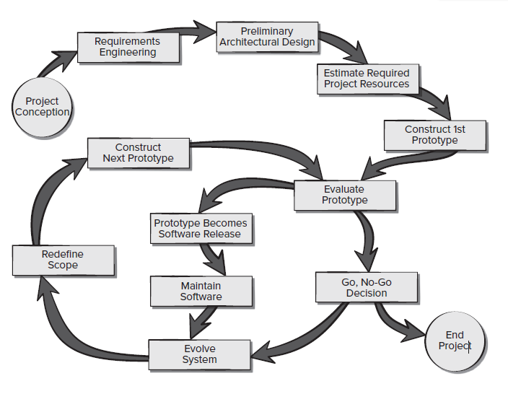
Recommended software process model
Pressman pp 66

Slide 80
Mughal brothers Pvt Ltd is the distributor of the Qarshi products in Pakistan. This company wants to automate the sale purchase and inventory system. Previously the company has no experience of information technology. They have no idea of what will be the size, cost and duration of the project.

Slide 81
Exercise
ABC department of university want a web based students management system. System should keep record of teachers, courses, students, attendance, registered courses and students marks. System should also facilitate the university department to assign courses to the teachers. The student and teachers have unique user name and password. System should allow registered students to search and register courses. Teacher can upload, modify and view students marks and attendance while student can only view the semester results, registered courses and attendance reports.

